Slide 1
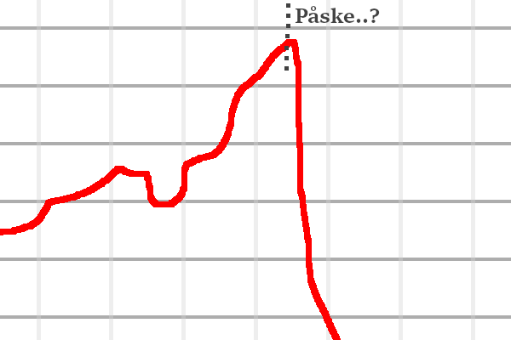


Status

Slide 2



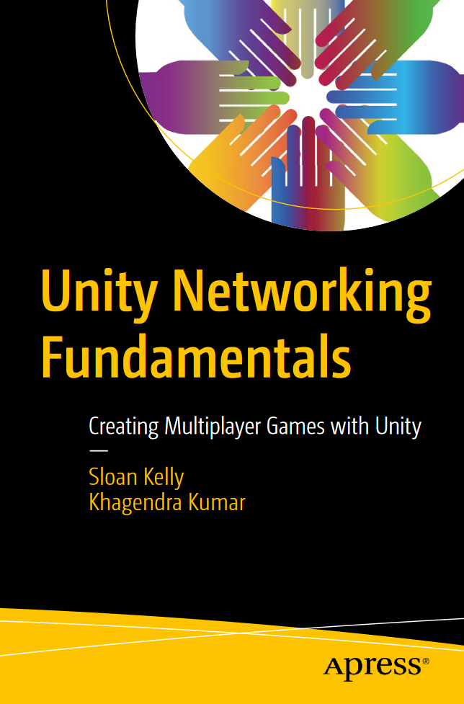

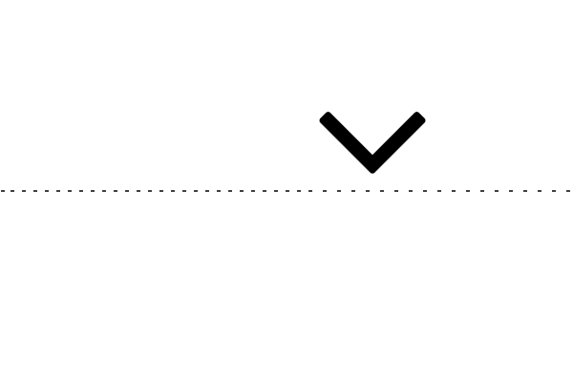





Hvor langt er man ?
Dockerfile
+ Containerization af Portefølje
+ Acquired Jenkins-image fra Dockerhub & built runnable, usable Jenkins-container
Jenkinsfile
> Pipeline build succesful
> Pipeline build forced fail
> Pipeline scripting + Groovy
> Pipeline plugins
> Pipeline E-mail notification ~
Unity Projekter
4 Semester Hello World Using TCP Sockets
4 Semester Fetch Example
4 Semester Weather App
4 Semester WebGl First Try
4 Semester Card WebGl
4 Semester Chess LAN
4 Semester Maze Shooter
4 Semester Tic-Tac-Toe
p. 239 / 259
65%ish
0%
100%

Slide 3
Hvad mangler man ?
> Jenkins auto gitrepo grab-&-deploy som Docker container - Doable!
> Working Notificering i Jenkins - - - Seriously ?
> (Auto) Testing i Jenkins - - - Questionable
—
> Networked custom-built Unity game / proof-of-concept
[vha. UNF’s NetLib / Unity Assets (Proton el. Fishnet) ]
> Networked chat lobby Unity app

Slide 4

Hvad fokus på, i sidste periode ?
> Trim to doable
> Overensstemmende med langsigtede læringsmål
> Time-limited last attempt på at få stuff til at virke eller deem’e @ point-of-failure
> Ensure alt er good på portefølje - Alle produkter uploadet & Læringsmål ‘overholdt’
Execute! Execute! Execute!

Slide 5
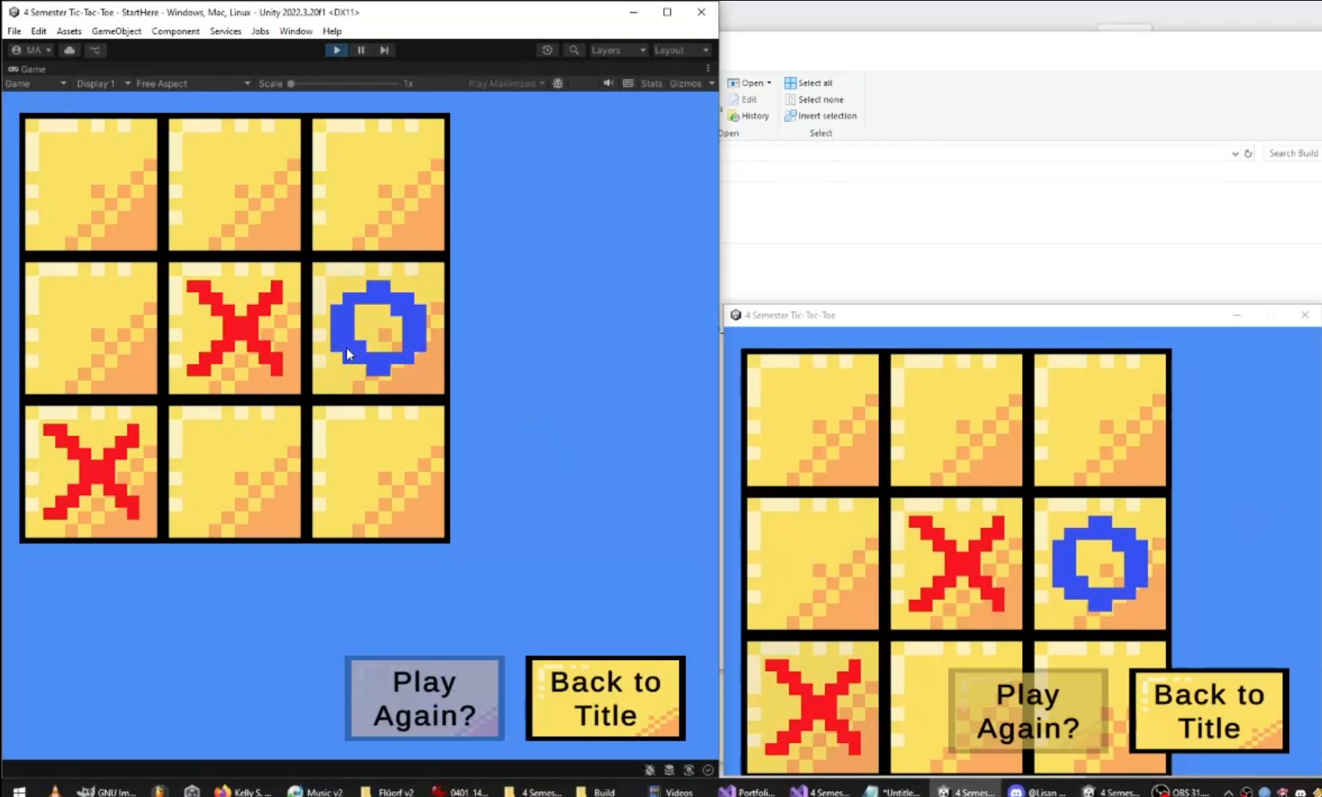
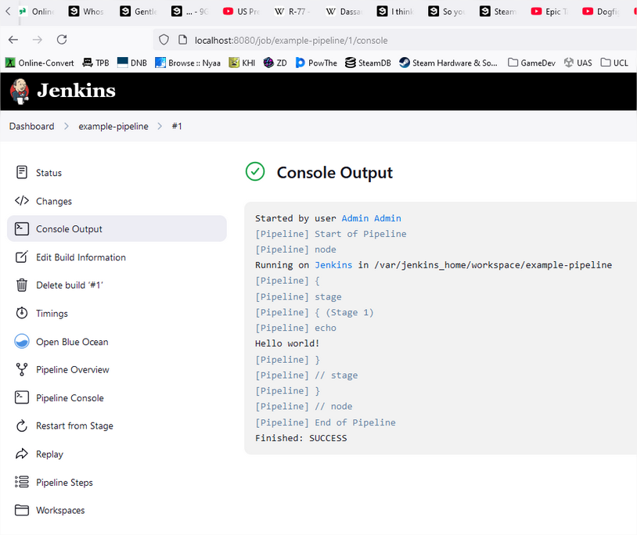
Amazing! Astonishing!
[Docker / Jenkins]-file + Groovy
https://greyrib.github.io/Products/Jenkinsfile_early

Slide 6
Tak fordi du så med!

